Slide 1
SAP HANA Upgrade

Slide 2
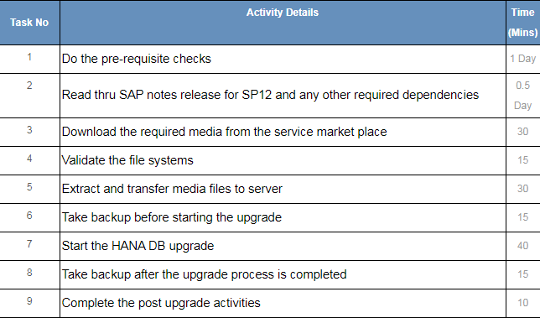
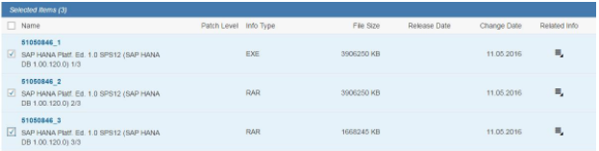
SAP HANA Upgrade
Project Plan/ Task List Pre-Upgrade Steps:
Download the media files
from SMP – service market place
https://service.sap.com/swdc

Slide 3
Required SAP notes and upgrade guide
http://help.sap.com/hana/SAP_HANA_Server_Installation_Guide_en.pdf
For information about supported operating systems for SAP HANA, see SAP Note 2235581 – SAP HANA: Supported Operating Systems
SUSE Linux Enterprise Server (SLES)
SAP Note 1944799 – SAP HANA Guidelines for SLES Operating System
SAP Note 1855805 – Recommended SLES 11 packages for HANA support on OS level
SAP Note 1954788 – SAP HANA DB: Recommended OS settings for SLES 11 / SLES for SAP Applications 11 SP3

Slide 4
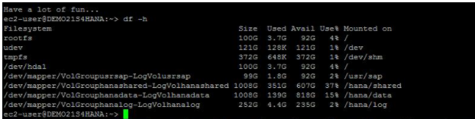
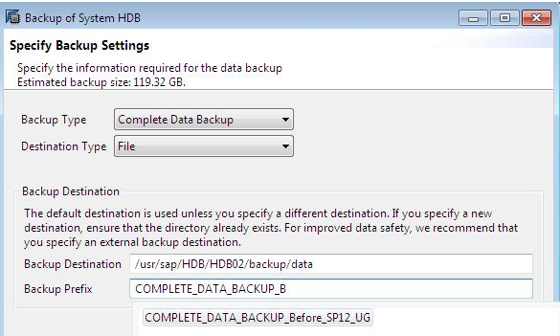
Check the OS level File system details and all the required permissions
Before Starting the HANA Database Update, Make sure that you have: a) A valid permanent SAP license for SAP HANA database. b) Username and Password for users SIDadm user, SYSTEM user,
S-userID c) Take Complete Backup of HANA Database.

Slide 5
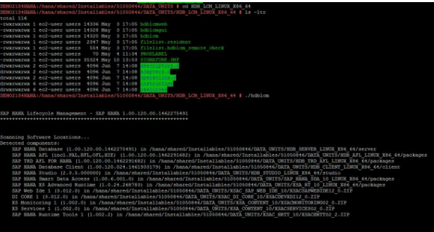
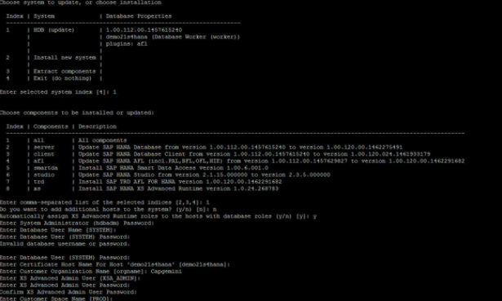
Upgrade Process
We will be performing upgrade thru command line; other ways of doing the upgrade is thru HDBLCMGUI.
Navigate to Installation Media > Run command – ./hdblcm

Slide 6
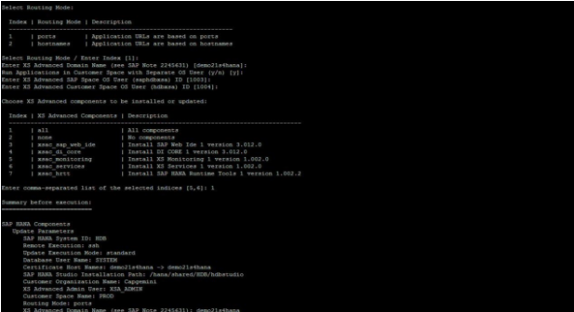
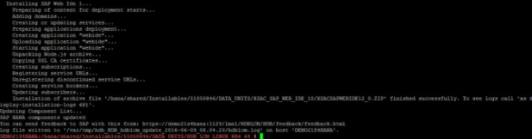
Upgrade
SAP HANA database upgrade is successfully completed

Slide 7
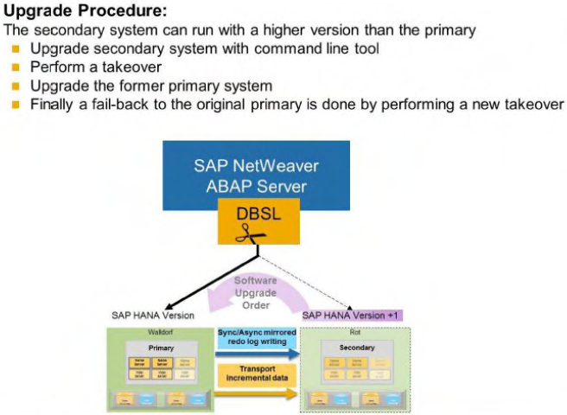
Zero Downtime Maintenance
SAP HANA offers Zero Downtime Maintenance together with SAP HANA System Replication. System Replication can be used to upgrade your SAP HANA systems because the secondary system can run with a higher software version than the primary system.
If System Replication is active, you can first upgrade the secondary system to a new revision and have it take over the role of the primary system. The takeover takes few minutes only and committed transactions or data are not lost. You can then do an upgrade on the primary system. which is now in the role of secondary.
The secondary system can be initially installed with the new software version or upgraded to the new software version when replication has already been configured. After the secondary has been upgraded. all data has to be replicated to the secondary system. When the secondary system is ACTIVE a takeover has to be executed on the secondary system. This step makes the secondary system productive with the new software version.

Slide 8
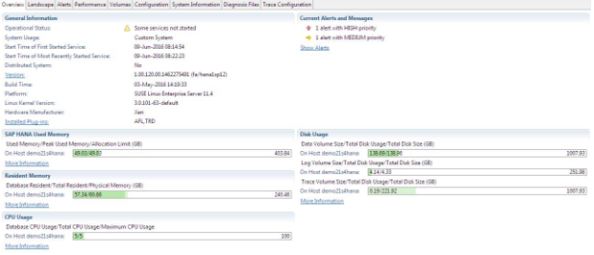
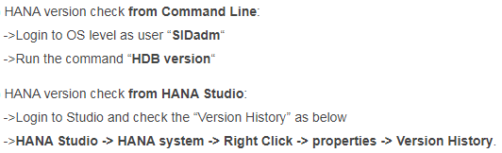
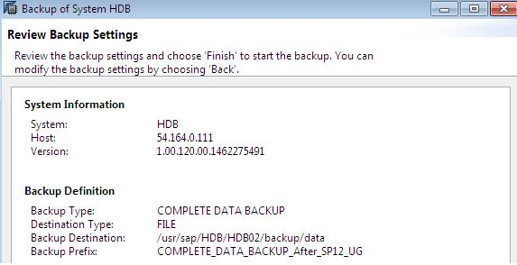
Post Upgrade
Validate HANA DB version
Post Upgrade
Final step is to take the backup after upgrade.
Update the client on the applications.
Start the applications.
SAP HANA Upgrade is successfully completed.

Slide 9
Updating Clients
Updating HANA Client: navigate to respective platform HANA Client folder “HDB_CLIENT_LINUX_X86_64” and run any one of the below scripts (GUI/CLI mode) as user “root”.
->./hdbsetup (starts in GUI Mode) ->./hdbinst (starts in command line mode) ->In the prompt, select the SAP HANA Database Client you want to Update. And Update starts…
INFO: SAP HANA Database Client installation path: “/hana/shared/SID/hdbclient“
Updating HANA Studio: navigate to respective platform folder like “HDB_STUDIO_LINUX_X86_64” and run any one of the below scripts (GUI/CLI mode) as user “root”.
->./hdbsetup (starts in GUI Mode) ->./hdbinst (starts in command line mode) ->In the prompt, select the SAP HANA Studio Installation you want to Update. And Update starts…
INFO: SAP HANA Database Client installation path: “/hana/shared/SID/hdbstudio“
How to Check SAP HANA Version after update:

